Slide 1
ZELO LAČNA GOSENICA
Eric Carle
Pripravila: Darja Dolenc

Slide 2
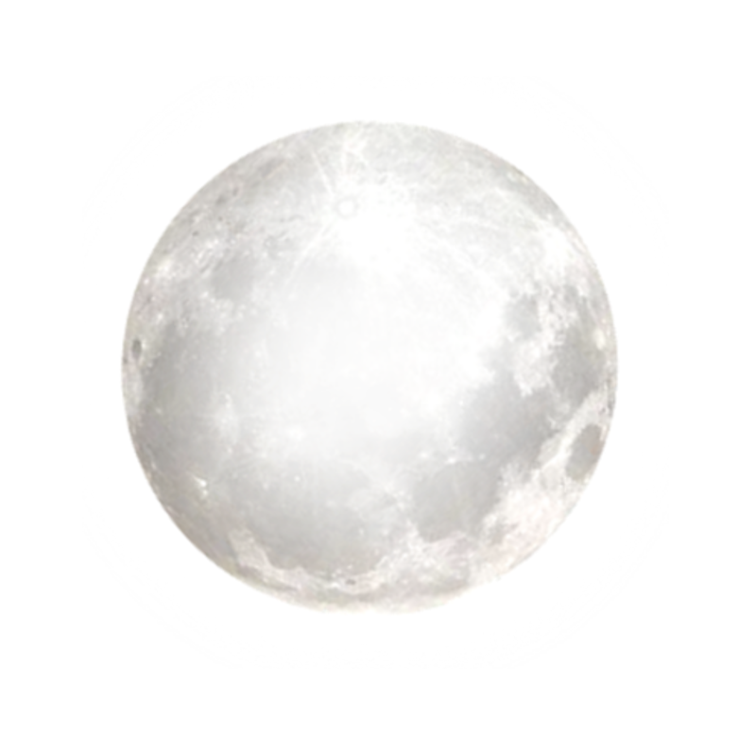

Slide 5
PONEDELJEK

Slide 6
TOREK

Slide 7
SREDA

Slide 8
ČETRTEK

Slide 9
PETEK

Slide 10
SOBOTA

Slide 12
NEDELJA

Slide 15
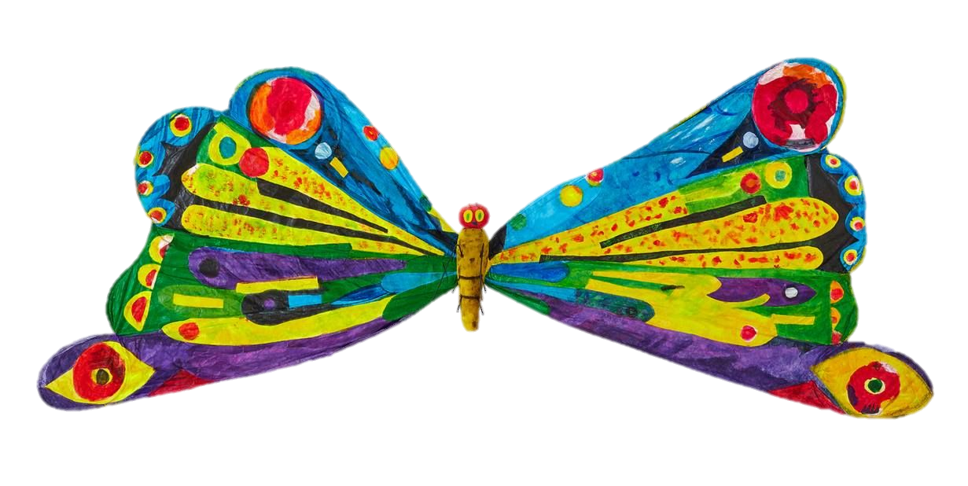

Slide 16
VIRI SLIK
https://www.pngfind.com/pngs/m/397-3972363_soil-vector-pile-star-hd-png-download.png
https://clipartart.com/images/clipart-green-leaves-1.png
https://img.clipartlook.com/leaf-clip-art-clipart-leaf-2504_3500.png
https://i.pinimg.com/originals/d8/6b/da/d86bda4ebc2e5dda5c3b1fd6de2e181c.png
https://www.pngitem.com/pimgs/m/75-757665_larva-very-hungry-caterpillar-transparent-hd-png-download.png
https://i.pinimg.com/originals/7e/28/89/7e288947c2c179f39398a72fdad19e0c.png
https://toppng.com/uploads/preview/transparent-background-sun-clipart-11563032022om1hqfixnw.png
https://www.pngitem.com/pimgs/m/50-507591_cloud-png-clip-arts-transparent-background-rain-clipart.png
https://2.bp.blogspot.com/-JTgE0SUZJj8/T8Ec3Wp-79I/AAAAAAAAQ2I/rPof-nyHuw8/s640/Enzo_Mari_La_Mela%C2%A9nova68.com.jpg
https://easydrawingart.com/wp-content/uploads/2019/07/how-to-draw-a-pear.jpg
https://www.pngitem.com/pimgs/m/280-2809301_plum-clipart-hd-png-download.png
https://cdn1.vectorstock.com/i/1000x1000/05/55/fresh-strawberry-clipart-vector-9730555.jpg
https://www.netclipart.com/pp/m/8-80981_orange-clip-art-free-free-clipart-images-orange.png
https://cdn.clipart.email/99723ec0774122c1a4ea73f00c13fec5_best-slice-of-cake-illustrations-royalty-free-vector-graphics-_612-612.jpeg
https://clipartart.com/images/99-ice-cream-clipart-7.png
https://lh3.googleusercontent.com/proxy/TDtnROdbDo88StIkid8fEpCtdBJEkNCKTXCsda9lKCig2mnHqbARlF_pkr4X2fnufmi8iR8a5e02e3PT95dhazX6f3MG26WztQ
https://mpng.subpng.com/20180323/ayw/kisspng-macaroni-and-cheese-clip-art-cheese-5ab4c2ad210c57.1469319415217957571354.jpg
https://www.pinclipart.com/picdir/middle/222-2229425_vector-illustration-of-salami-cured-sausage-fermented-clipart.png
https://www.epicentrofestival.com/wp-content/uploads/2019/12/Lollipop-Lollipop-Clipart-720x1021.jpg
https://i.pinimg.com/originals/a1/f5/46/a1f5468dd06812b62f7c27a6ed86f9a1.jpg
https://www.pngitem.com/pimgs/m/70-704621_cartoon-sausage-clipart-sausage-png-transparent-png.png
https://www.kindpng.com/picc/m/8-86823_cupcake-free-to-use-clip-art-cup-cake.png
https://i.pinimg.com/736x/e9/d3/ff/e9d3ffb8c043c0030656beb8a2ea3105.jpg
https://clipartart.com/images/butterfly-eric-carle-clipart-3.jpg

